Slide 1

HOMOGENEOUS LINEAR EQUATIONS
PRESENTED BY
MADHURIMA RAWAT
ROLL NO-$300012821042$
DATASCIENCE(CSE)
CHHATTISGARH SWAMI VIVEKANANDA TECHNICAL UNIVERSITY

Slide 2
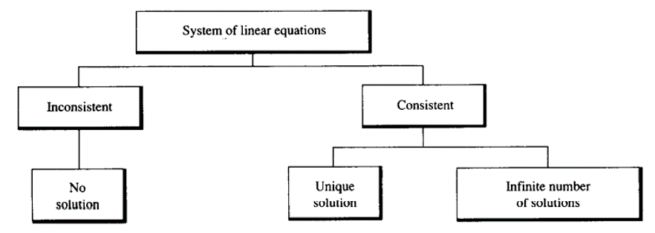
TYPES OF LINEAR EQUATIONS

Slide 3
Consistency and inconsistency
(A) A linear equation is said to be consistent if:
I) It has a solution either unique or infinite many solutions
(B) A linear equation is said to be inconsistent if:
I) It does not have a solution neither unique or infinite many solutions
A homogeneous system of linear equation is always consistent

Slide 4
HOMOGENEOUS AND NON-HOMOGENEOUS LINEAR EQUATIONS
(A) HOMOGENEOUS LINEAR EQUATIONS
I) NO CONSTANT TERMS
II) GENERAL FORM: AX=O
(B) NON-HOMOGENEOUS LINEAR EQUATIONS
I) CONSTANT TERMS
II) GENERAL FORM: AX=B

Slide 5
WHAT IS HOMOGeNEOUS LINEAR EQUATION?
A homogeneous linear equation is a linear equation in which the constant term is 0.
There is no constant terms in homogeneous linear equation except for 0.
The general form of homogeneous linear equation is :
Where A is the matrix containing coefficients of unknown variable and X is unknown variable and 0 is zero order matrix.
AX= 0

Slide 6

Solution of homogeneous linear equation
There are two type of solution in homogeneous linear equation-
$1$ .Unique solution:
I) |A| not equal 0
II) The only possible solution is: x= 0,y= 0 This is known as trivial solutions
$2$.Infinite many solution
I) |A| equal to 0
II) Many possible solutions

Slide 7

Rank of matrix($ρ$)
Rank of a matrix is determined by :
(A) If equation have unique solution:
I) $ρ$ [A]=No of unknown variable= order of matrix
I) 𝜌 [A]=No of unknown variable= order of matrix
(B) If equation have infinite many solution:
II) $ρ$ [A]< No of unknown variable and order of matrix
II) 𝜌 [A]< No of unknown variable and order of matrix

Slide 8
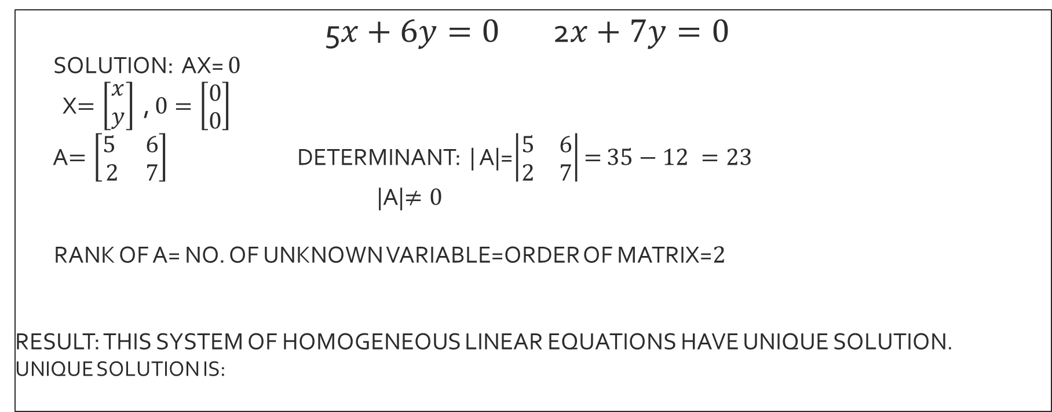



Example of homogeneous linear equations($2$x$2$ matrix)
5$x+6y=0$2$x+7y=0$
SOLUTION: AX= $0$
X$=\left[\begin{matrix}x \\ y\end{matrix}\right]$ , $0=\left[\begin{matrix}0 \\ 0\end{matrix}\right]$
A$=\left[\begin{matrix}5 & 6 \\ 2 & 7\end{matrix}\right]$ DETERMINANT: | A|=$\left|\begin{matrix}5 & 6 \\ 2 & 7\end{matrix}\right|$ $=$ $35−12 =23$
|A|$≠0$
RANK OF A= NO. OF UNKNOWN VARIABLE=ORDER OF MATRIX=$2$
RESULT: THIS SYSTEM OF HOMOGENEOUS LINEAR EQUATIONS HAVE UNIQUE SOLUTION.
UNIQUE SOLUTION IS:
$$ρ[A]=2$$
$$x=0 y=0$$

Slide 9
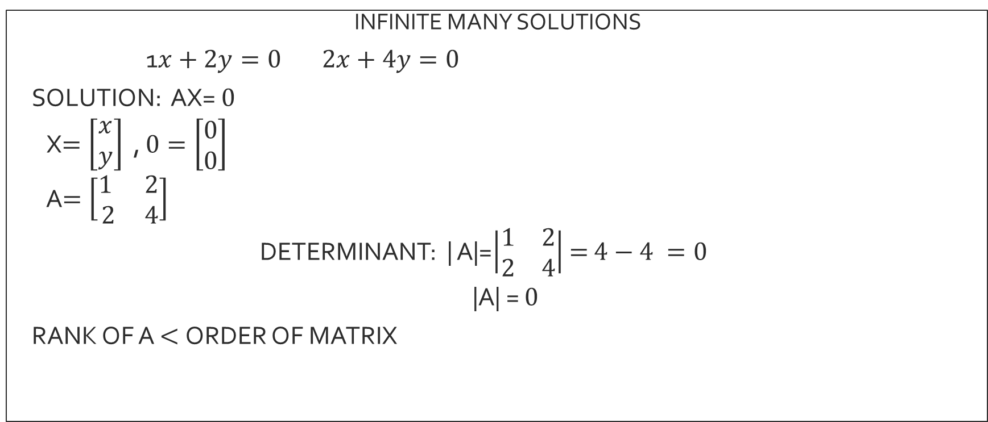


Infinite many solution($2$X$2$ matrix)
INFINITE MANY SOLUTIONS
1$x+2y=0 2x+4y=0$
SOLUTION: AX= $0$
X$=\left[\begin{matrix}x \\ y\end{matrix}\right]$ , $0=\left[\begin{matrix}0 \\ 0\end{matrix}\right]$
A$=\left[\begin{matrix}1 & 2 \\ 2 & 4\end{matrix}\right]$
DETERMINANT: | A|=$\left|\begin{matrix}1 & 2 \\ 2 & 4\end{matrix}\right|$ $=$ $4−4 =0$
|A| = $0$
RANK OF A $<$ORDER OF MATRIX
$$ρ<2$$

Slide 10
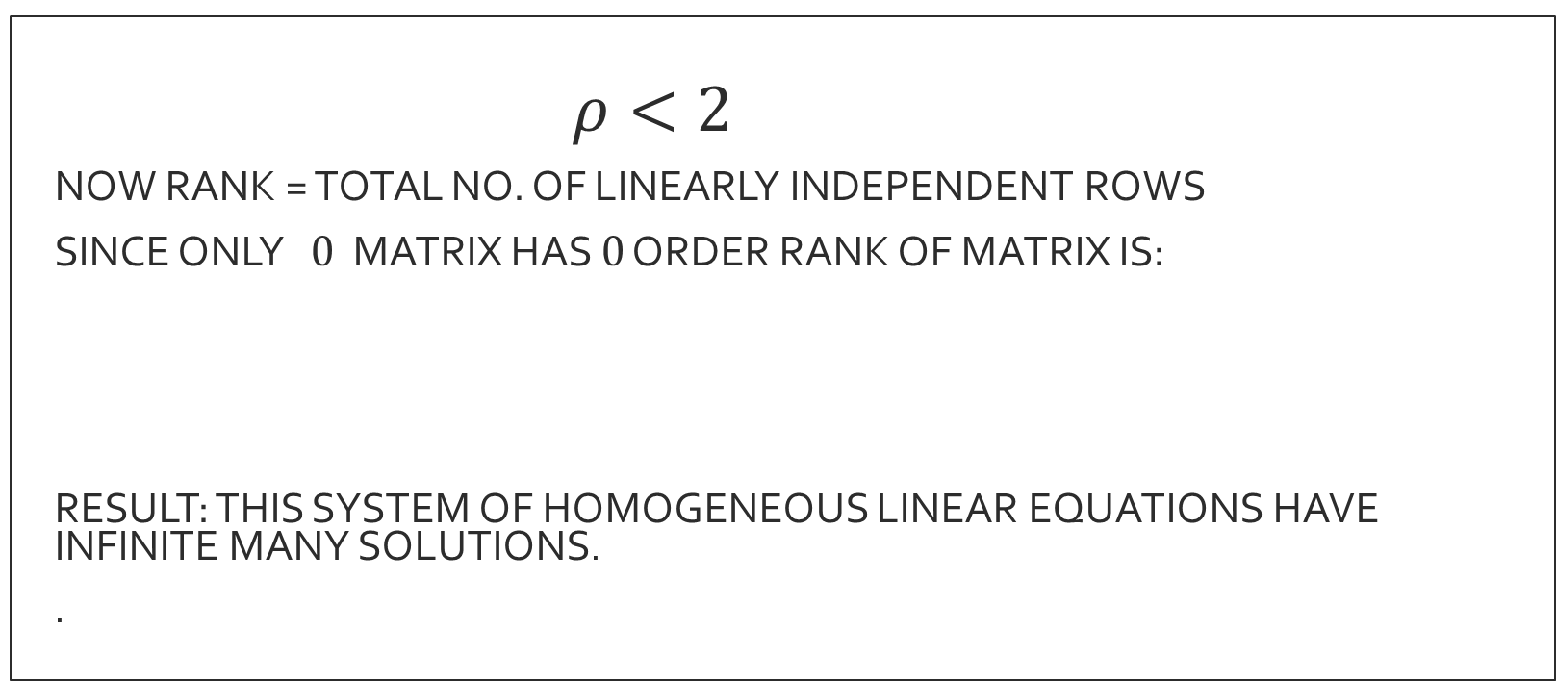


FINDING RANK($2$X$2$ matrix)
$ρ<2$
NOW RANK = TOTAL NO. OF LINEARLY INDEPENDENT ROWS
SINCE ONLY $0$ MATRIX HAS $0$ ORDER RANK OF MATRIX IS:
RESULT: THIS SYSTEM OF HOMOGENEOUS LINEAR EQUATIONS HAVE INFINITE MANY SOLUTIONS.
.
$$ρ[A]=1$$

Slide 11
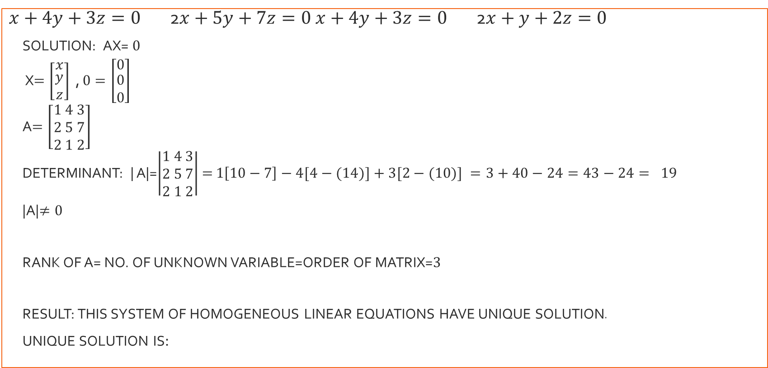



Example of homogeneous linear equations($3$x$3$matrix)
$x+4y+3z=0$2$x+5y+7z=0$ $x+4y+3z=0$2$x+y+2z=0$
SOLUTION: AX= $0$
X$=\left[\begin{matrix}x \\ \begin{aligned}y \\ z\end{aligned}\end{matrix}\right]$ , $0=\left[\begin{matrix}0 \\ \begin{aligned}0 \\ 0\end{aligned}\end{matrix}\right]$
A$=\left[\begin{aligned}1 4 3 \\ 2 5 7 \\ 2 1 2\end{aligned}\right]$
DETERMINANT: | A|=$\left|\begin{aligned}1 4 3 \\ 2 5 7 \\ 2 1 2\end{aligned}\right|$ $=$ $1\left[10−7\right]−4[4−(14)]+3[2−(10)] =3+40−24=43−24= 19$
|A|$≠0$
RANK OF A= NO. OF UNKNOWN VARIABLE=ORDER OF MATRIX=$3$
RESULT: THIS SYSTEM OF HOMOGENEOUS LINEAR EQUATIONS HAVE UNIQUE SOLUTION.
UNIQUE SOLUTION IS:
$$ρ[A]=3$$
$$x=0,y=0,z=0$$

Slide 12
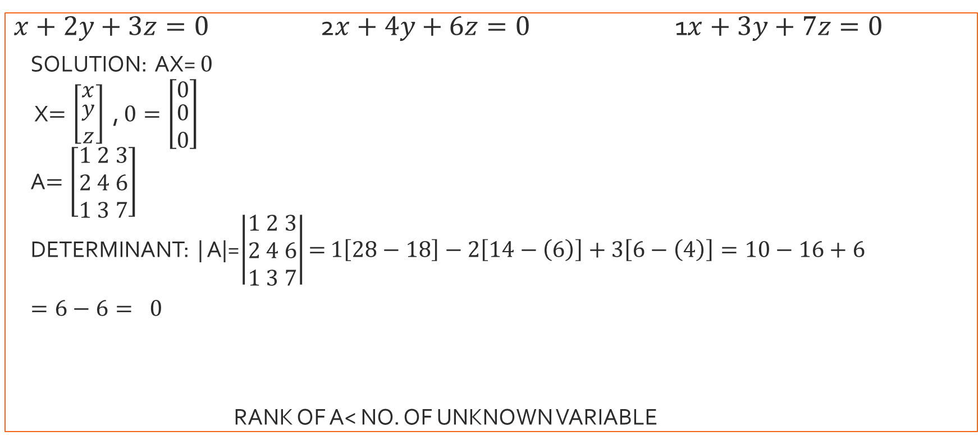
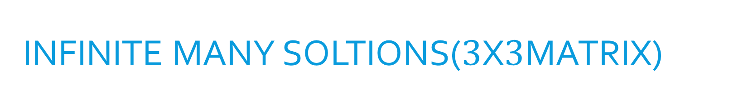

INFINITE MANY SOLTIONS($3$x$3$MATRIX)
$x+2y+3z=0$2$x+4y+6z=0$ 1$x+3y+7z=0$
SOLUTION: AX= $0$
X$=\left[\begin{matrix}x \\ \begin{aligned}y \\ z\end{aligned}\end{matrix}\right]$ , $0=\left[\begin{matrix}0 \\ \begin{aligned}0 \\ 0\end{aligned}\end{matrix}\right]$
A$=\left[\begin{aligned}1 2 3 \\ 2 4 6 \\ 1 3 7\end{aligned}\right]$
DETERMINANT: | A|=$\left|\begin{aligned}1 2 3 \\ 2 4 6 \\ 1 3 7\end{aligned}\right|$ $=$ $1\left[28−18\right]−2\left[14−\left(6\right)\right]+3\left[6−\left(4\right)\right]=10−16+6$
$=6−6= 0$
RANK OF A< NO. OF UNKNOWN VARIABLE
|A|=$0$

Slide 13
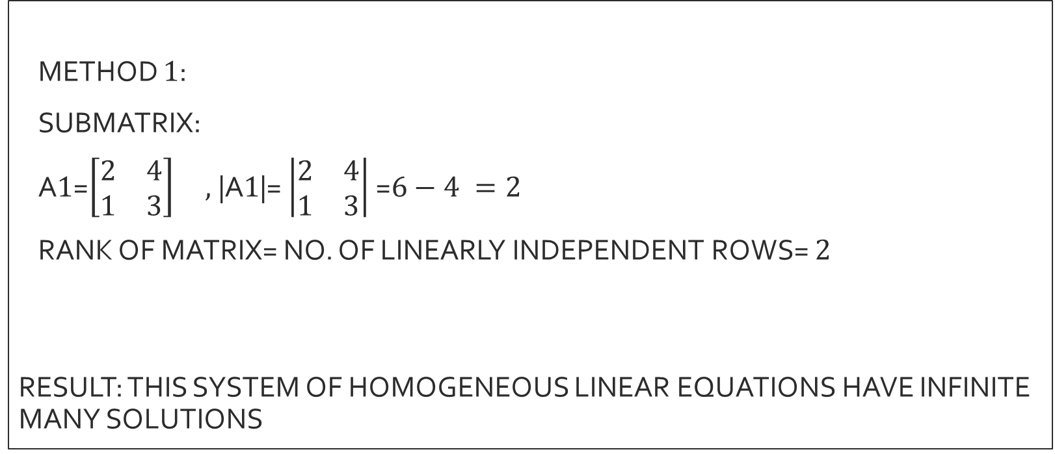



FINDING RANK($3$X$3$matrix)
METHOD $1$:
SUBMATRIX:
A$1$=$\left[\begin{matrix}2 & 4 \\ 1 & 3\end{matrix}\right] ,$|A$1$|= $\left|\begin{matrix}2 & 4 \\ 1 & 3\end{matrix}\right|$ =$6−4 =2$
RANK OF MATRIX= NO. OF LINEARLY INDEPENDENT ROWS= $2$
RESULT: THIS SYSTEM OF HOMOGENEOUS LINEAR EQUATIONS HAVE INFINITE MANY SOLUTIONS
$$ρ[A]<3$$
$$ρ[A]=2$$

Slide 14
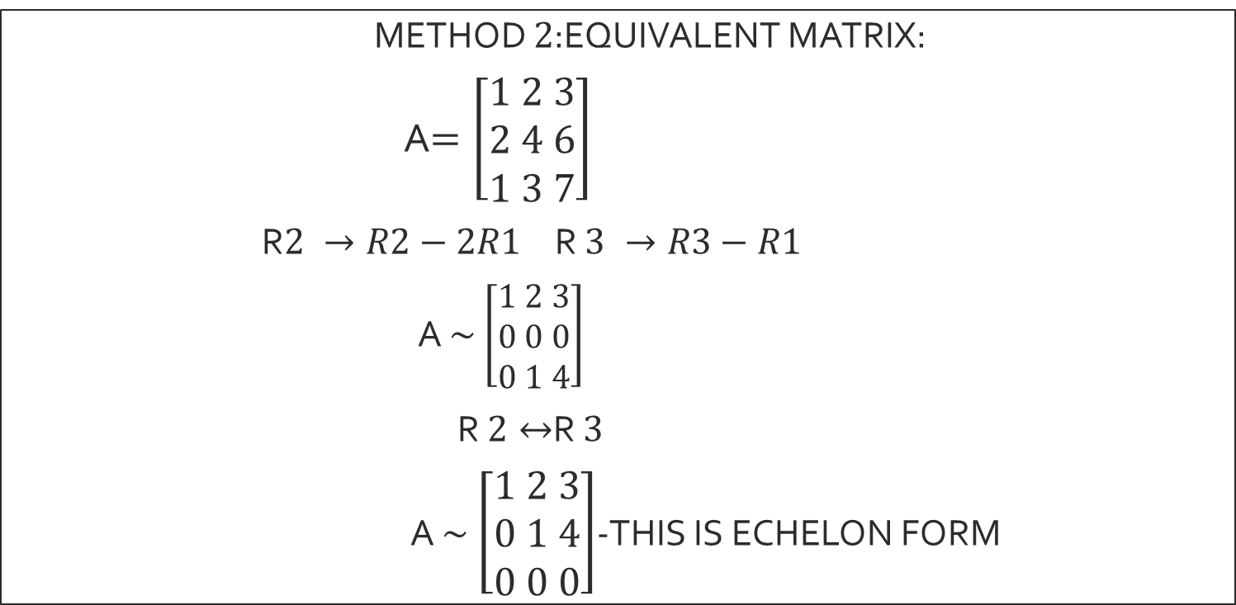

METHOD $2$:EQUIVALENT MATRIX
METHOD $2$:EQUIVALENT MATRIX:
A$=\left[\begin{aligned}1 2 3 \\ 2 4 6 \\ 1 3 7\end{aligned}\right]$
R$2 →R2−2R1$R $3 →R3−R1$
A $\sim$ $\left[\begin{aligned}1 2 3 \\ 0 0 0 \\ 0 1 4\end{aligned}\right]$
R $2↔$R $3$
A $\sim$ $\left[\begin{aligned}1 2 3 \\ 0 1 4 \\ 0 0 0\end{aligned}\right]$-THIS IS ECHELON FORM

Slide 15
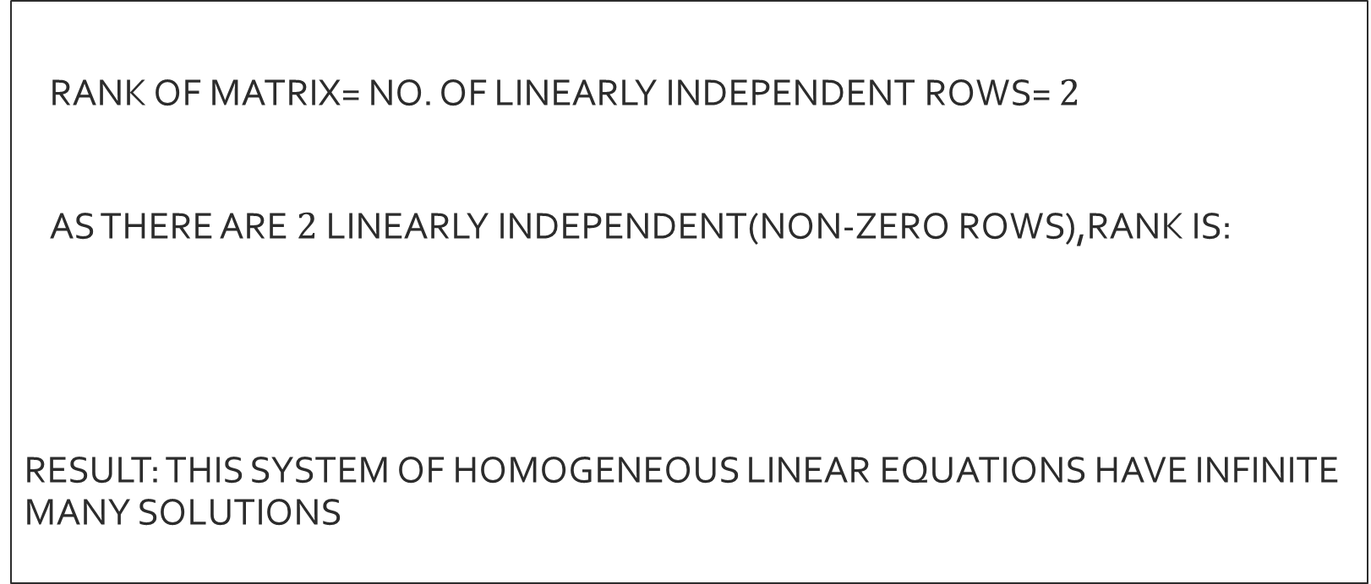


Method $2$
RANK OF MATRIX= NO. OF LINEARLY INDEPENDENT ROWS= $2$
AS THERE ARE $2$LINEARLY INDEPENDENT(NON-ZERO ROWS),RANK IS:
RESULT: THIS SYSTEM OF HOMOGENEOUS LINEAR EQUATIONS HAVE INFINITE MANY SOLUTIONS
$$ρ[A]=2$$

Slide 16
APPLICATION OF HOMOGENEOUS LINEAR EQUATIONS
I) These are used when we do not need constant terms in our equation.
II) Used in cryptography
III) Used in computer graphics ( translation,contraction and extraction)
IV) Used in animations.
V) Used in aerospace, healthcare and economics
VI) Used in chemistry in balancing of chemical equations

Slide 17
THANK YOU FOR LISTENING TO ME
ANY QUESTIONS?

